Slide 1

Database Technolgy In Software Engineering Environment
WEITING LI

Slide 2
01
What is Database?
Definition:
A collection of interelated data stored electronically in a computer system.

Slide 3
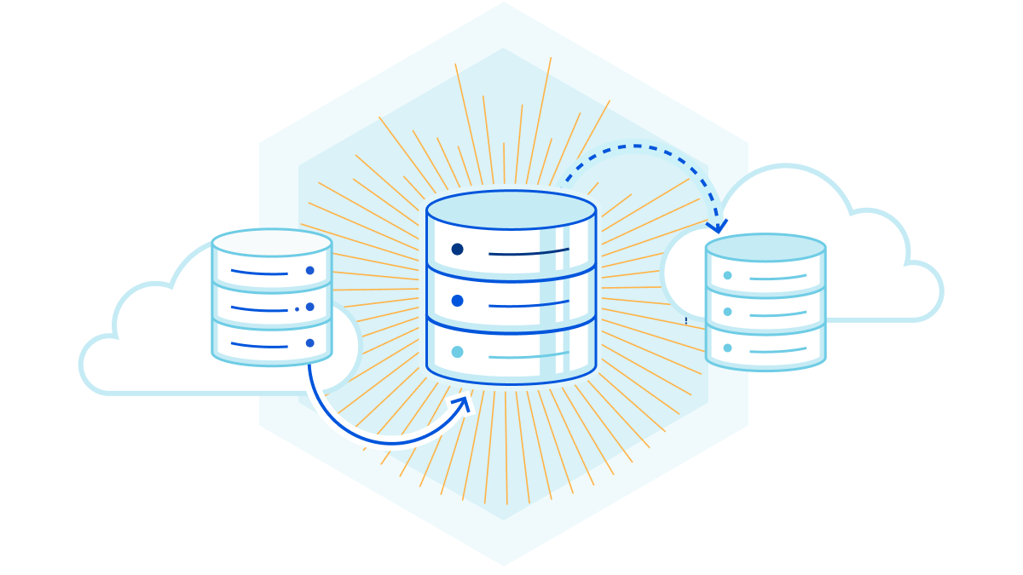
Property of Databases
Mini-world
Logically coherent and integrated.
Access is user-Friendly and efficient.
Nonredundant data.
Data independence.

Slide 4
02
What is Database Technology?
comprises: 1. concepts; 2. systems;
3. methods; 4. tools
to support the construction
and operation of databases.

Slide 5
Data modeling
01
Persistence
02
Data Integrity
Properties of Database Technology
03
Secondary storage
07
Quering
04
Distribution
08
Relational
Object-oriented
Object-relational
Concurrency control
05
Stored persistently
Functionality to allow concurrent access
Security
06
To prevent malicious access
Semantic integrity control mechanism are provided
Indexing, clustering,
and resource allocation
Data can be retrieved as needed; And has flexible, powerful interfaces
Prevent damage from accidents or increase efficiency

Slide 6
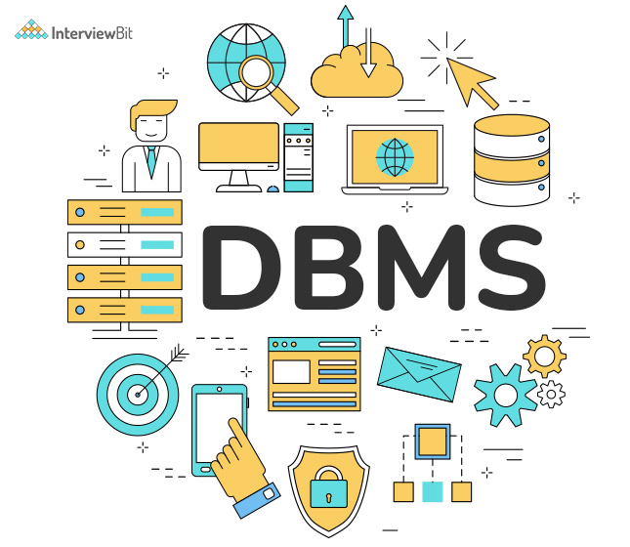
Database Management Systems (DBMS)
nothing more than a computerized data-keeping system
Manipulation of the data or management for the database itself
4 types of databases: inverted list, hierarchic, network or relational

Slide 7
Pause And Think

Slide 8
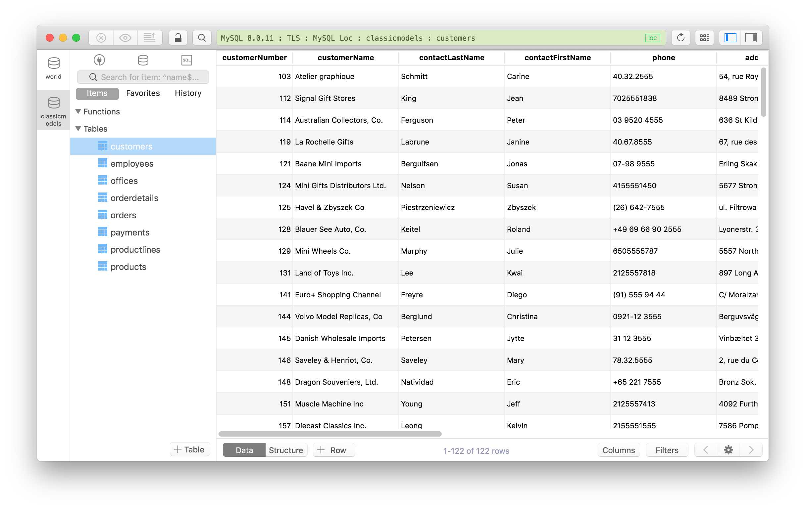
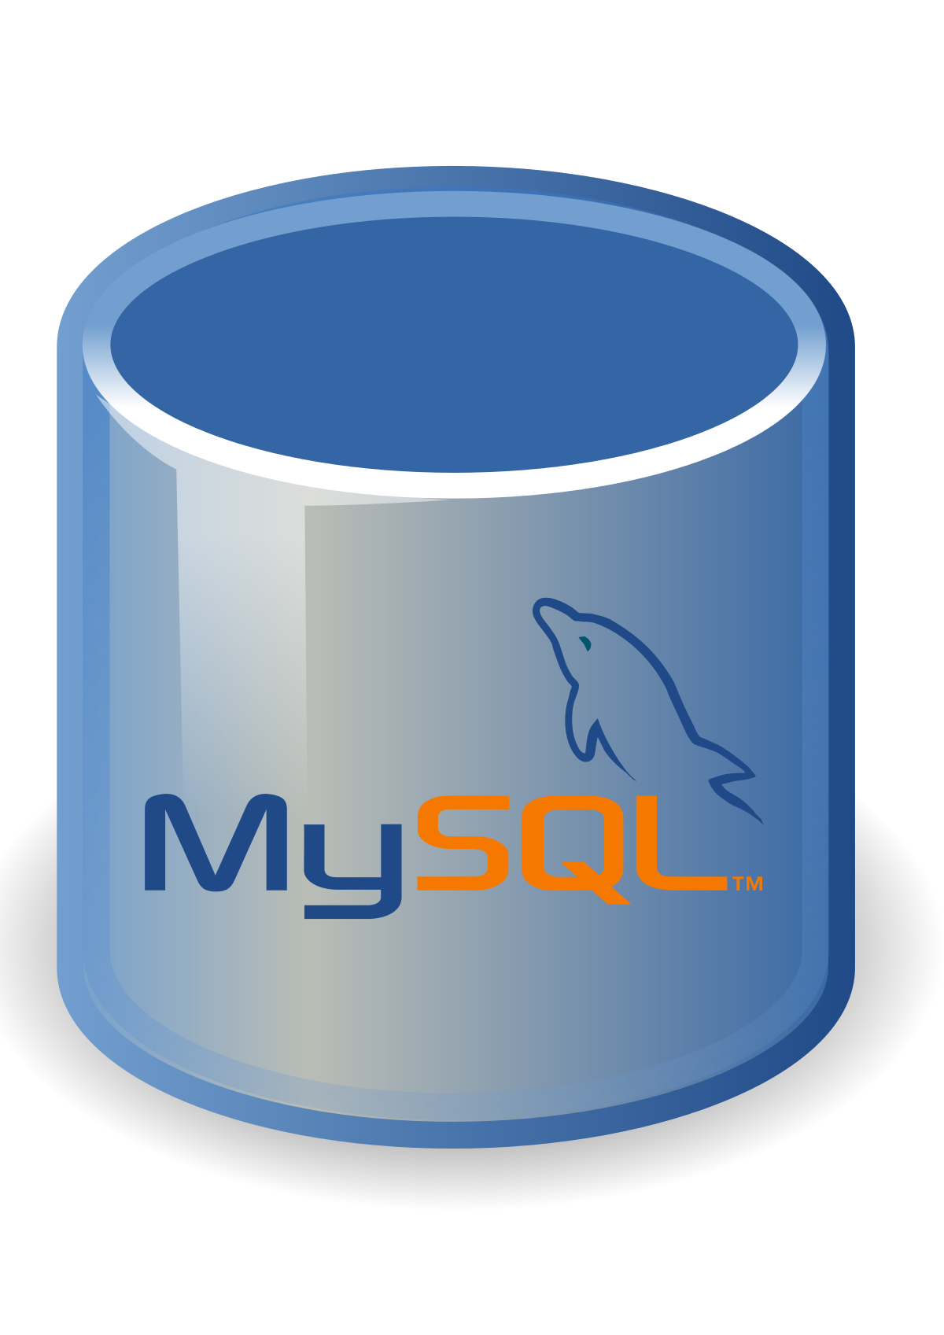
Example of DBMS
My SQL
is an open-source relational database management system (RDBMS) with a client-server model.
found in 1995
high efficiency, reliability and costless
Reference: [7]

Slide 9
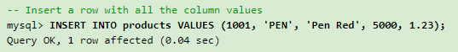
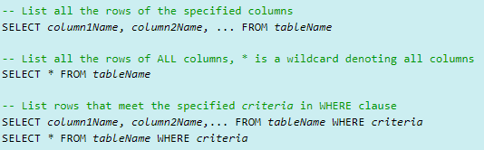
Basic MYSQL operations
Reference: https://www3.ntu.edu.sg/home/ehchua/programming/sql/MySQL_Beginner.html
Select which database to use:
Insert a row into the database:
Query the dataset:

Slide 10
03
Database Technology in SEE
How Software engineering environment(SEE) can use database technology to its advantage

Slide 11
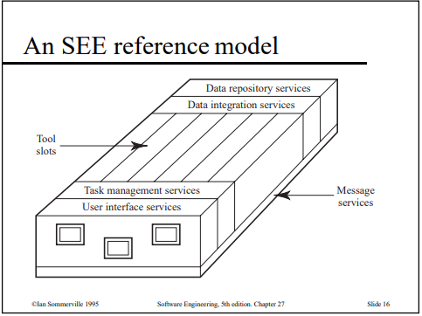
Software Engineering Environment
Definition:
A software system that provides support for the development, repair, and enhancement of software, and for the management and control of these activities.
Characteristics:
Integrated environment facilities: platform, data,
presentatio, control, and process integration;
Designated to support team based activities;
Should support a wide range of software development activities;
Figure 1. An example of SEE model [1]

Slide 12
Persistent storage of software artifacts
Functional Requirements For Database Support In SEE
Artifact querying and retrieval
Support for cooperative design transcations
Tool Integration and portability
Artifact integrity and consistency
Version management
Representation of software processes
Collection and evaluation of software development

Slide 13
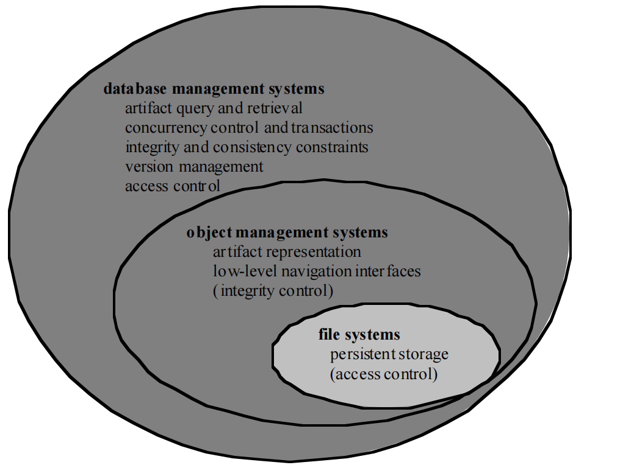
History
Databse Management System & Object management systems (OMS)
Developed Early in mid 80’s to early 90’s
Artifact representation and persistence
Rudimentary navigation interfaces
Low-level integrity control
Figure 2. The difference between DBMS and OMS [4]

Slide 14
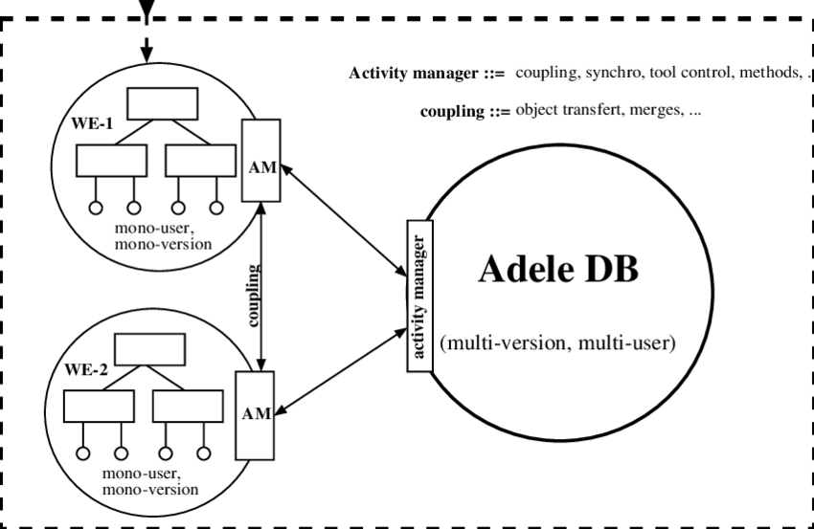
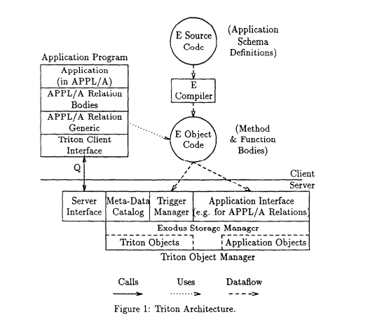
Example of OMS
Figure 3. Adele DB OMS Diagram[2]
Figure 4. Tridon OMS Diagram [3]

Slide 15
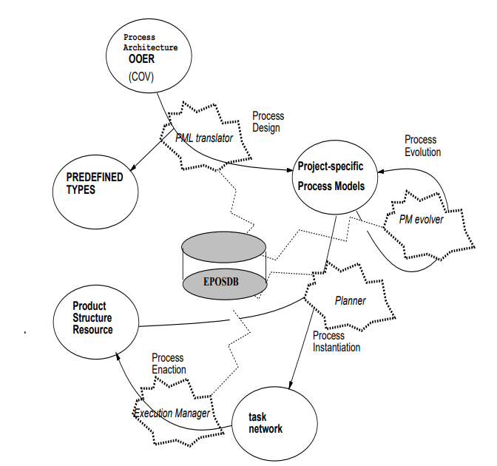
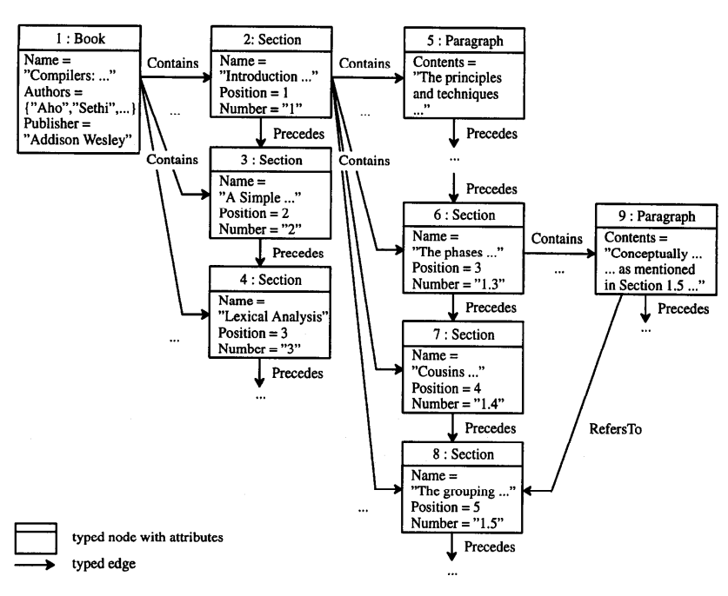
Proprietary DBMS for SEE
Figure 6. Visualization of EPOSDB life-cycle [5]
1. EPOSDB Software Engineering Database :
General Entity Relationship (ER)-based DBMS
Manage complex & evolving data structures
Novel change oriented versioning (COV)
Used in EPOS SEE
2. GRAS Software Engineering Database System :
Graph- Oriented SE database system
Handle different coarse and fine-grained objects
Support incremental computation of derived data
undo/redo of data modification
Figure 5. Graph representation of the structured text [6]

Slide 16
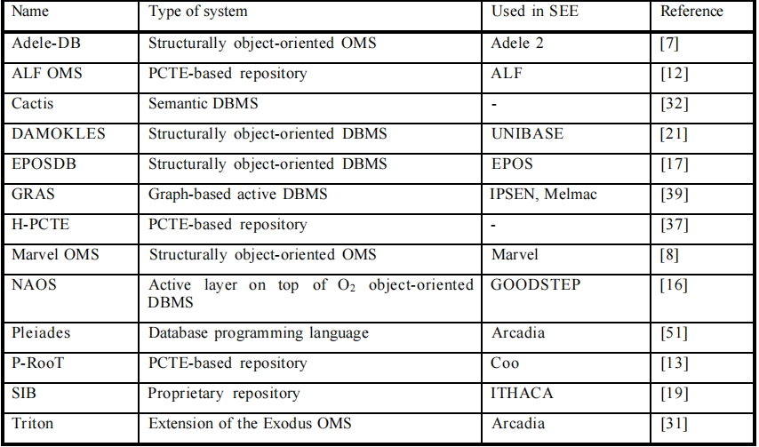
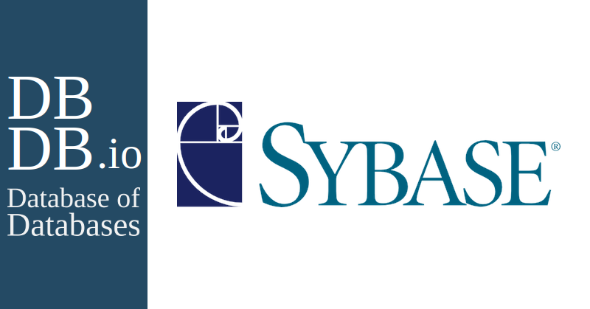
Commercial DBMS for SEE
Figure 6. sybase database [8]
Table 1. special purpose DBMS for SEE in industrial field [4]

Slide 17
References
[1] T. Anderson and D. Sharon, "A Complete Software Engineering Environment" in IEEE Software, vol. 14, no. 02, pp. 123-127, 1997.
doi: 10.1109/52.582983 keywords: {} url: https://doi.ieeecomputersociety.org/10.1109/52.582983
[2] Belkhatir, Noureddine & Melo, Walcelio. (1994). Supporting Software Development Processes in Adele 2. Comput. J.. 37. 621-628.
10.1093/comjnl/37.7.621.
[3] Dennis Heimbigner. 1992. Experiences With an Object Manager for a Process-Centered Environment. In Proceedings of the 18th International
Conference on Very Large Data Bases (VLDB '92). Morgan Kaufmann Publishers Inc., San Francisco, CA, USA, 585–595.[4] Dittrich, Klaus R., Dimitrios
Tombros, and Andreas Geppert. "Databases in software engineering: a roadmap." Proceedings of the Conference on the Future of Software Engineering.
2000.
[5] Jaccheri, Maria Letizia et al. “Software process modeling and evolution in EPOS.” Proceedings Fourth International Conference on Software
Engineering and Knowledge Engineering (1992): 574-581.
[6] Norbert Kiesel, Andy Schuerr, Bernhard Westfechtel,Gras, a graph-oriented (software) engineering database system,Information Systems,
Volume 20, Issue 1,1995,Pages 21-51,ISSN 0306-4379, https://doi.org/10.1016/0306-4379(95)00002-L.
[7] Reference for picture on Slide 8: https://tableplus.com/blog/2018/07/mysql-how-to-install-sample-database.html
[8] picture of sybase database source: https://dbdb.io/db/adaptive-server-enterprise

